Slide 1









My Number Interactive Workbook
$$×$$
$$\frac{1}{2}$$
$$÷$$
$$+$$
$$−$$
$$\frac{3}{5}$$
$$7$$
Name
Class
Teacher
Term 1 Semester 1
$$5^{2}$$
$$\sqrt{9}$$
1

Slide 2
Contents
Glossary or Formula Page
Page
Date
Description
2
3

Slide 3
Tasks
24
7
30
Essential Question
Questions
Notes
Summary
4
5

Slide 4
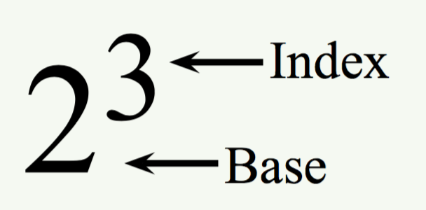
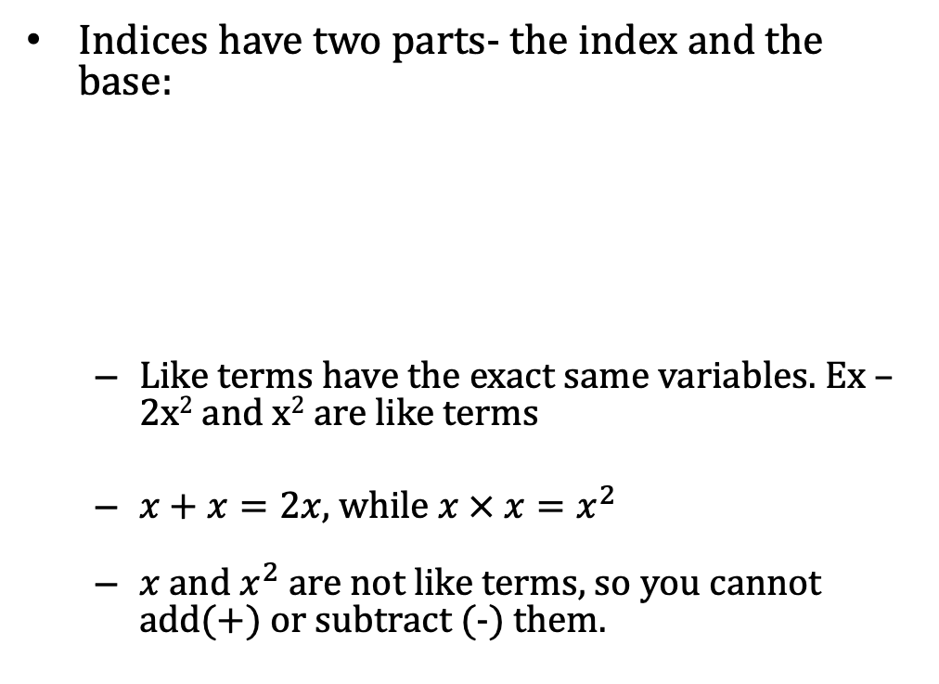
24
7
30
Date
Index Notation
EQ – What are the Index Laws and how do I apply them?
What is an index?
Indices have two parts- the index and the base:
Like terms have the exact same variables. Ex – 2x² and x² are like terms
$x+x=2x$, while $x × x=x^{2}$
$x$ and $x^{2}$ are not like terms, so you cannot add(+) or subtract (-) them.
What is a like term

Slide 5
24
7
30
Date
Index Notation
EQ – What are the Index Laws and how do I apply them?
There are laws that govern how we solve problems with indices, these are called index laws.
Index law 1: a^{m} x a^{n} = a^{m+n}
When multiplying two indices together, you add them – you can only add like bases
y³ x y⁴
= y³⁺⁴
=y⁷
REMEMBER: if there is and “a” and a “b”, only multiply “a” by “a” and “b” by “b” eg:
a⁴b³ x a²b becomes a⁴ x a² x b³ x b =
= a⁴⁺² x b³⁺¹
⁼ a⁶b⁴

Slide 6
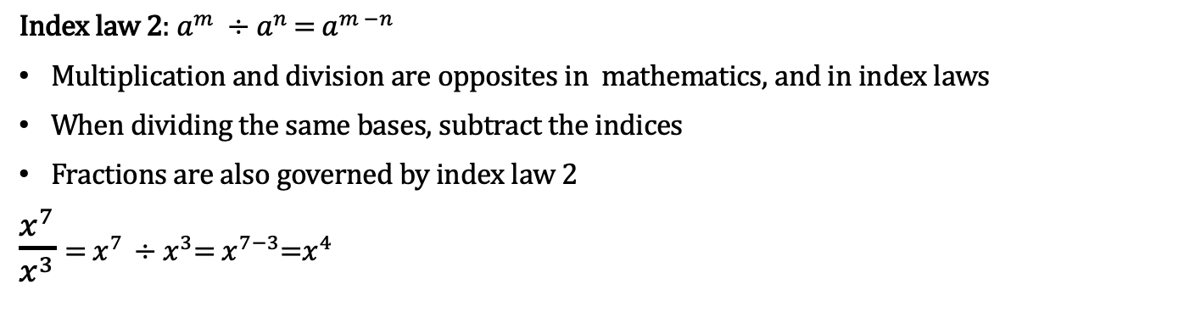
24
7
30
Date
Index Notation
EQ – What are the Index Laws and how do I apply them?
Index law 2: $a^{m} ÷a^{n }$= $a^{m −n}$
Multiplication and division are opposites in mathematics, and in index laws
When dividing the same bases, subtract the indices
Fractions are also governed by index law 2
$\frac{x^{7}}{x^{3}}$ = $x^{7 }÷x^{3}$= $x^{7−3}$=$x^{4}$
Index law 3: (a^{m})^{n} = a ^{m x n}
When there are indices inside and outside of a brackets, they multiply.
Eg; (x⁴)³ - think about what indicies mean.
(x⁴)³ means (x⁴) x (x⁴) x (x⁴), then use the first index law,
x⁴⁺⁴⁺⁴ ⁼ x¹²
4 + 4 +4 is the same as 4 x 3, therefore we can use the third law to simplify that if an index is inside the bracket, you multiply by the index outside the brackets.

Slide 7
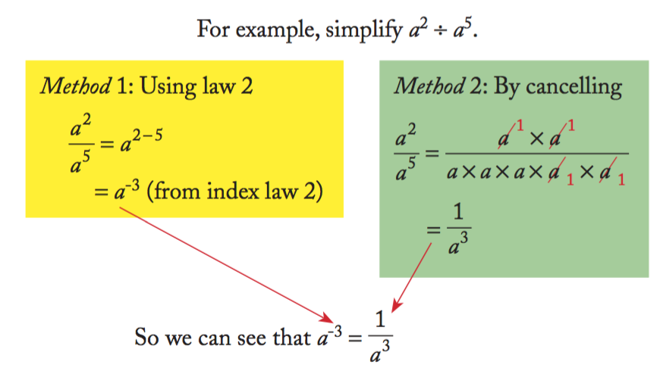

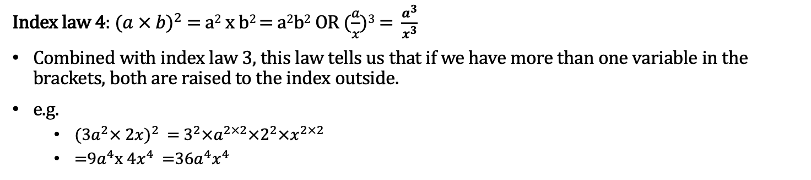

24
7
30
Date
Index Notation
EQ – What are the Index Laws and how do I apply them?
Index law 4: ($a × b)^{2}$ = a² x b² = a²b² OR $(\frac{a}{x}$)³ = $\frac{a^{3}}{x^{3}}$
Combined with index law 3, this law tells us that if we have more than one variable in the brackets, both are raised to the index outside.
e.g.
(${3a}^{2}× 2x)^{2}$= $3^{2}×a^{2×2}×2^{2}×x^{2×2}$
=$9a^{4}$x $4x^{4}$=36$a^{4}x^{4}$
Index law 5: y ⁻³ = $\frac{1}{y^{3}}$
When there is a negative index, we can write it below a one to make it positive.
The example on the right shows how this process of cancelling negative indices can be used to create the positive below a one.
Also- $\frac{1}{x^{−3}}=x^{3}$

Slide 8
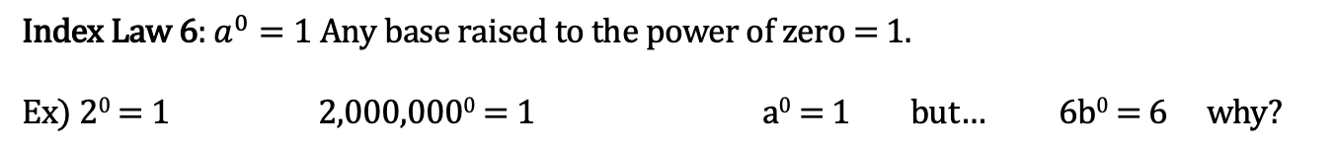
24
7
30
Date
Index Notation
EQ – What are the Index Laws and how do I apply them?
Index Law 6: $a^{0}=1$ Any base raised to the power of zero = 1.
Ex) 2⁰ = 1 2,000,000⁰ = 1 a⁰ = 1 but… 6b⁰ = 6 why?

Slide 9
Complete Chapter 3 Worksheet B
Questions 1 - 8

Slide 10
Notes Review
24, 7 ,30
Date
Title
Essential question
Notes complete
Notes complete with colour and diagrams
Questions completed
Contents page filed in
Formula page filled in

Slide 11
Homework
Review your notes and write a summary answering the essential question.

